Slide 1
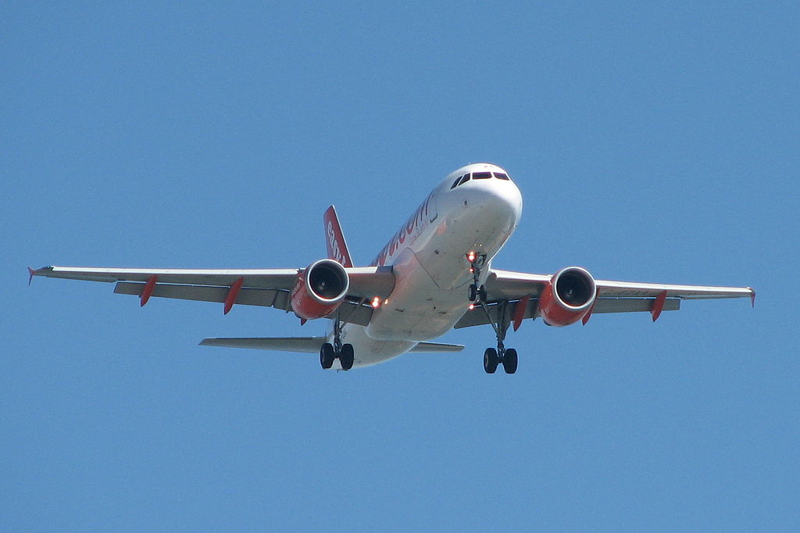
OR travel on a budget
Flight Sims

Slide 2

Outline
We have a business idea: CREATE a flight search engine.

Slide 3

Story
IMAGINE you want to go on vacation OR just want to go somewhere and work remotely.
AND.
You are a bit flexible with time and destination.

Slide 4
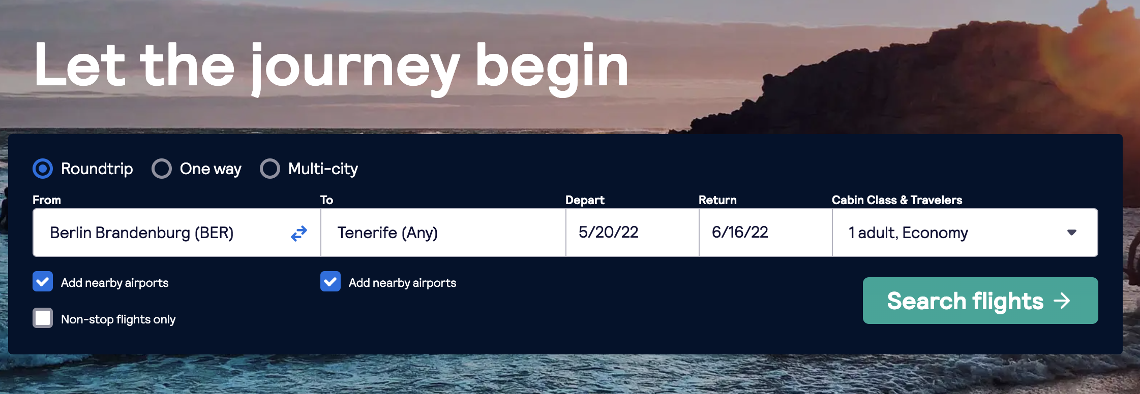
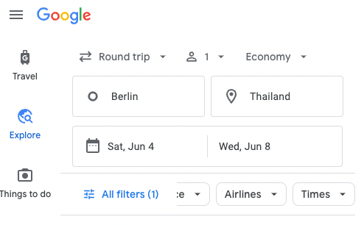
Story
You try to get some interesting results from the big guys.
They do offer some flexibility with destinations, but the results are obscure and the dates are fixed.

Slide 5

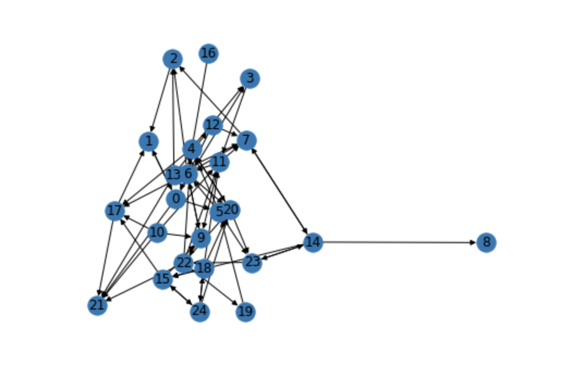
Story
The big guys suck a lot of energy and time. They make you do the hard work and make you tired fast ☺.

Slide 6

What
We want to give our users something simple but powerful. Like pandas
Data Frame.
We don’t want them to work hard,
we want to help them, OK?

Slide 7


What
We want our search flexible from the start, adjustable on the fly and present search results in an accessible manner.

Slide 8


How
We want to work with adjustable distance based groups of departures and destinations. In search results we want to combine local transportation and accommodation.

Slide 9
Project objective
First get some data and prototype the flight search solutions, combine data with accomodations.
See if we get any ecouraging results. For now we want significantly cheaper flights with probability 0.6
The data must provide info on flights dates and prices.
Airport geolocations. Available accomodations around.

Slide 10

De DATA
The travel portals API did not promise to yield significant results.
I found a flight data set on Kaggle. Cleaned_2018_Flights.csv 9534417 rows. Has 238 airports of origin - destination and prices, no dates or geolocations.
The data is clean, no missing values.
Groups of origins and destinations have Median of prices STDs = 96.15$

Slide 11

Da DATA
We going to need coordinates.
I found a data set with geolocations for the airports.
'US_airports_geo.csv’ shape = 341 unique airports, 7 columns, has no missing values for geo data and airport IATA.
Inner join it with flights dataset ON cols IATA and Origin.
Now we have Geolocation for our flights data.

Slide 12



Teh DATA
Flights data has no times. I decide to make them up
by spreading flights times evenly for each origin - destination group for departures.
Arrivals calculated by dividing flight distance by 600 – the commercial jet speed.

Slide 13
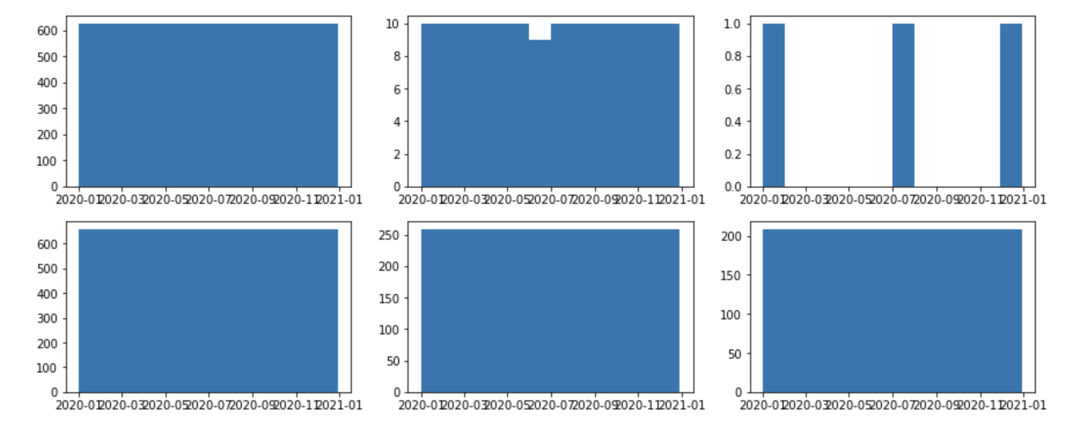
Deh DATA
I check the distribution of the flight dates by randomly sampling and plotting 6 groupby items several times.

Slide 14
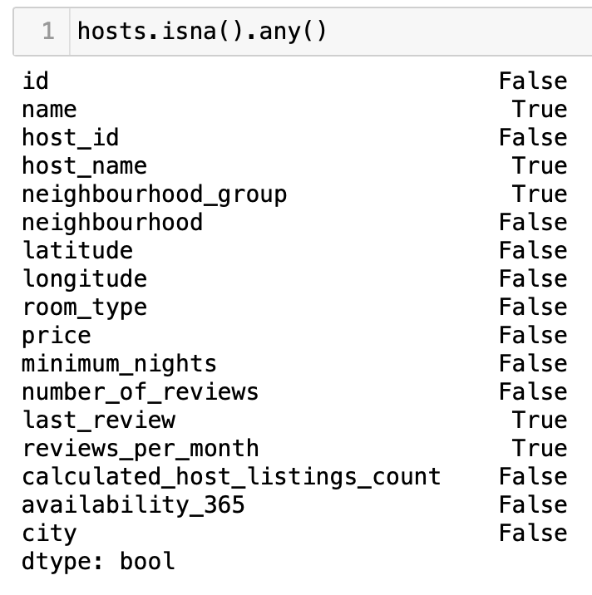
Teh DATA
Accomodations data is AB_US_2020.csv
Shape = 226030, 17
28 unique Cities .
No missing vals in critical data.

Slide 15
Grouping the Airports
Merge the airports and the hosts USING city.
Check for unique airports. ==18 of 341
Use KKN to attach to existing airport labels.
Divide data set onto subsets with and without labels.
Resulting in (117542, 18) and (120575, 18) sets.

Slide 16
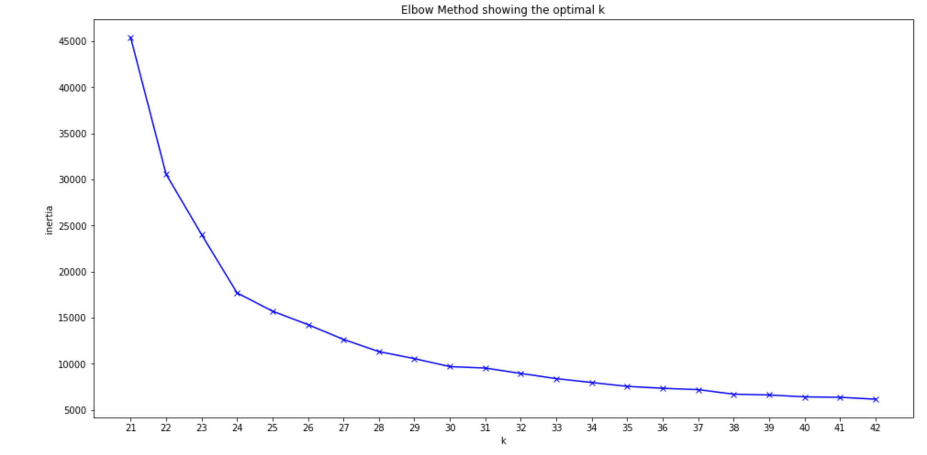
Grouping the Airports
Try K-means, they are distance based.
And need no labeled data

Slide 17
Grouping the Airports
Impute missing values using
Most Frequent so the classifier
has more data.
I want as many clusters as possible,
here 37 is used.
It is still barely enough…
In visualisation the value of lower quantile of the accommodation price is used.

Slide 18
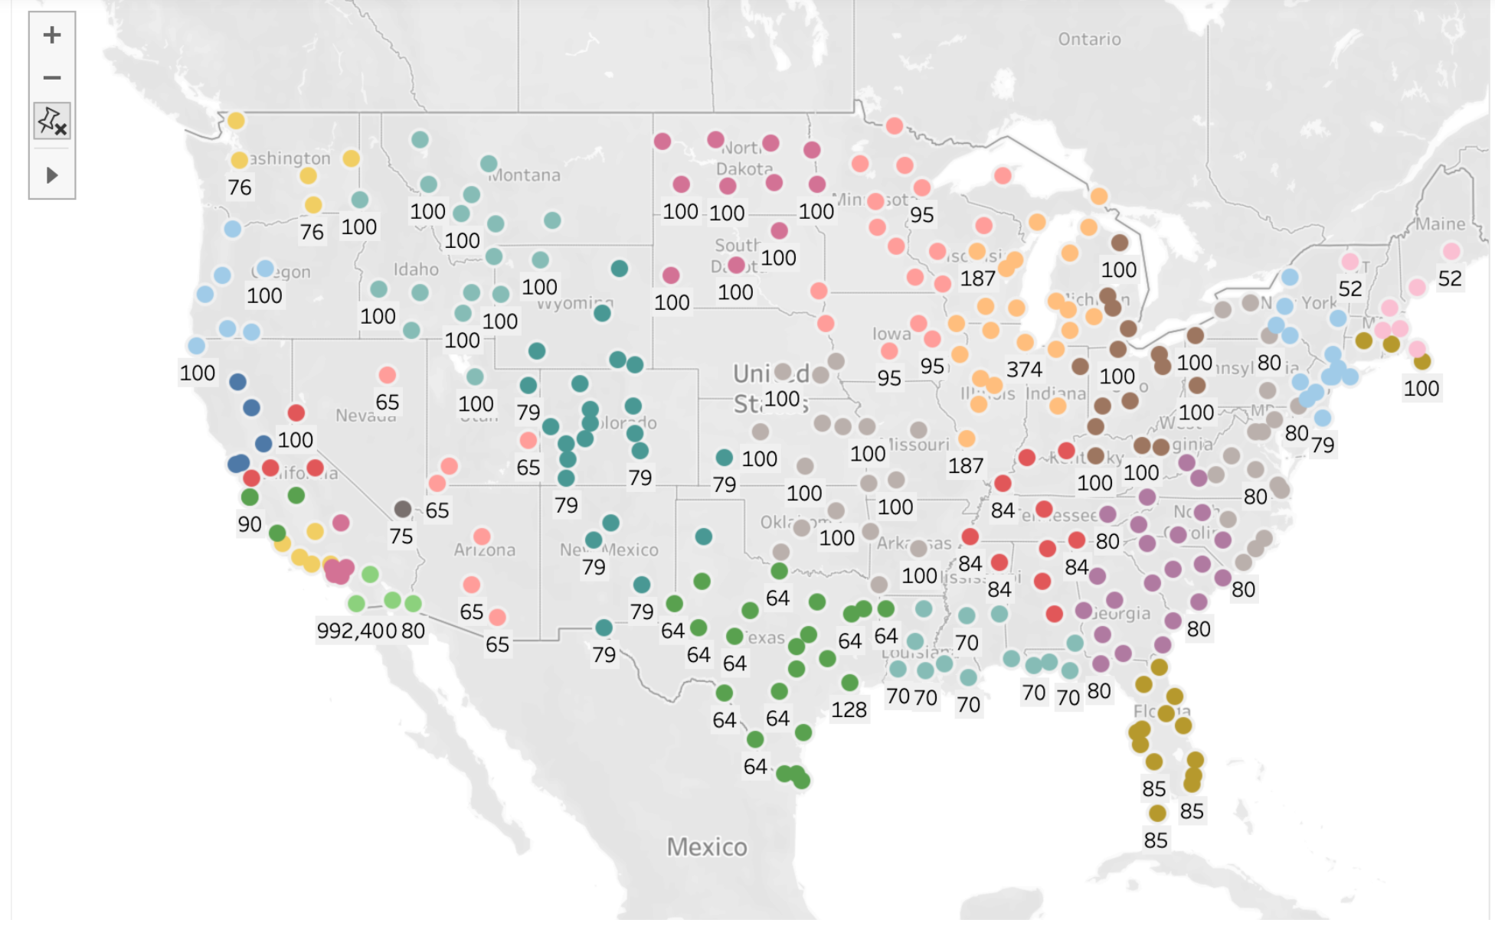
Grouping the Airports
Tableau is forced to repeat the colors for different clusters.
Result looks better tho.

Slide 19
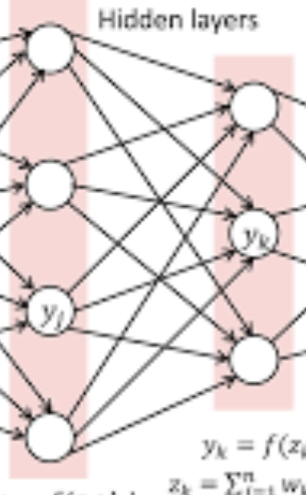
The Search.
Given the scope the search is very straight forward. We have destination and origin. Each has a group of neighbors. We check for flights from all origin cluster nodes to all in destination cluster in a range of dates. We select
n – lowest priced results and return.
We compare them to the price of the direct flight on the given date.

Slide 20

Grouping the Airports
The disadvantage is that the K-means clusters are quite big and do not represent reality.
Also as we search the flights from different points, the clusters remain fixed, which means some origins are on the edges of the clusters. That distorts the results and makes my conclusions a bit unreliable.
Suddenly one day before the presentation I have an idea… Pandas

Slide 21

Grouping the Airports
Try to use Pandas superpowers to get a cluster for each airport.

Slide 22
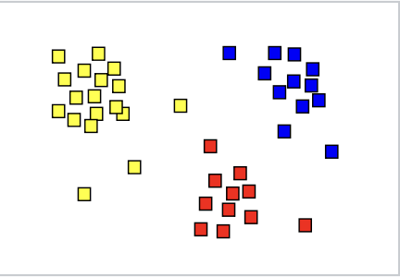
Grouping the Airports
Duplicate airports data and sort one along lattitude and second along longitude, for each element select N neighbors. Then get intersection for each pair of resulting sets.

Slide 23
Experiment
We take 100k sample with highest prices from all the flights.
We then sample 10k from those 100k randomly.
We run simulated search for each one of them.
Take 5 samples with lowest price from each search.
Each search is 1.6 seconds.

Slide 24
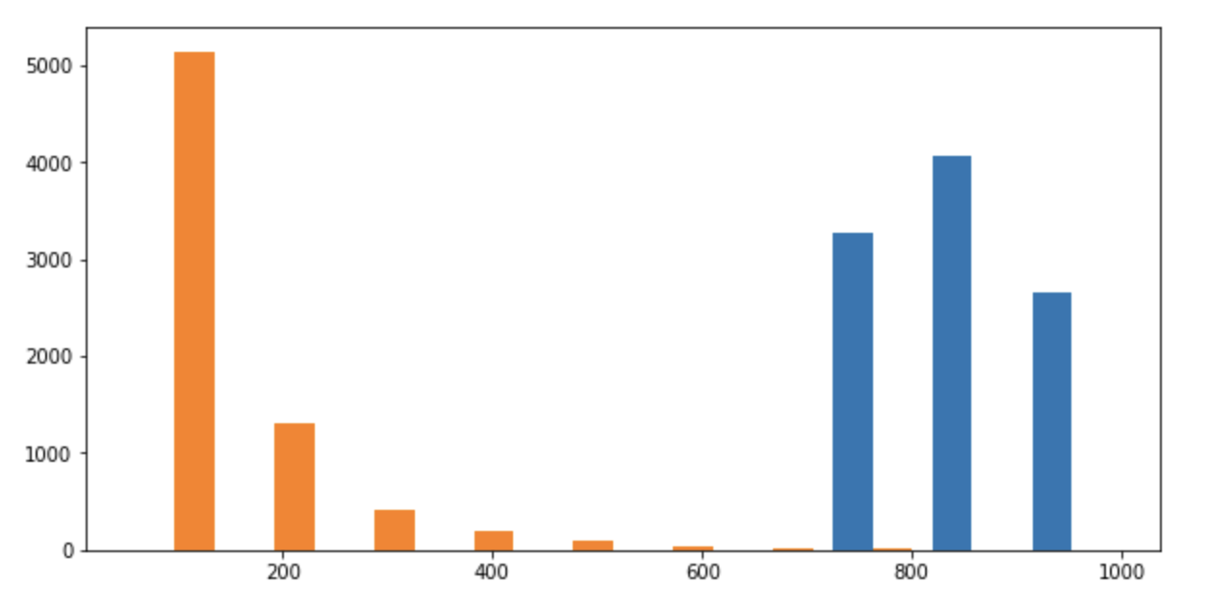
The efficiency of the search
is 0.72 > 0.6
Direct flights prices mean 856.4$
Alternative flights prices mean 136$
Experiment result

Slide 25
Reflecting
To do wish list:
Get more accommodation data if possible Airbnb API.
Use European budget airlines API.
Add complexity to the search.
Make search faster.
Tnank you,
Daniel Friedman danelskih@gmail.com

